Slide 1



KULTUREHIRE DATA ANALYTICS INTERNSHIP
UNDERSTANDING THE CAREER ASPIRATIONS OF GEN Z
By
Sudha R
01
WWW.REALLYGREATSITE.COM

Slide 2

TOOLS USED FOR
DATA ANALYSIS
Microsoft Excel
MySQL
Power BI
02

Slide 3

STAGE I
EXCEL DASHBOARD
03

Slide 4
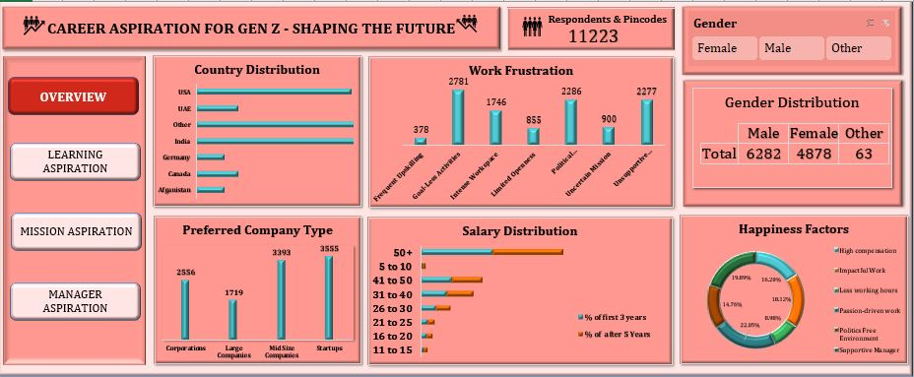
04

Slide 5
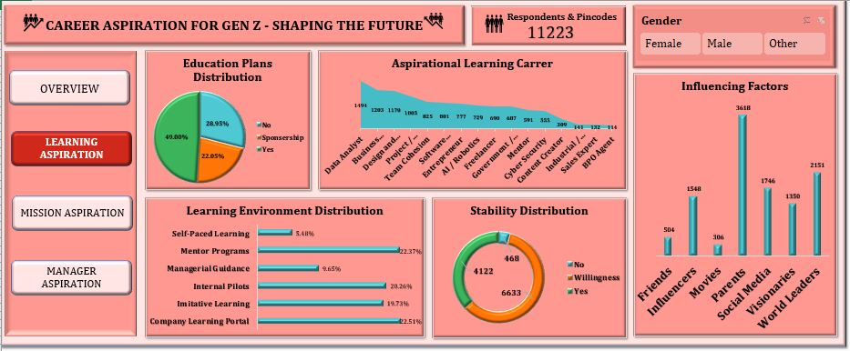
05

Slide 6
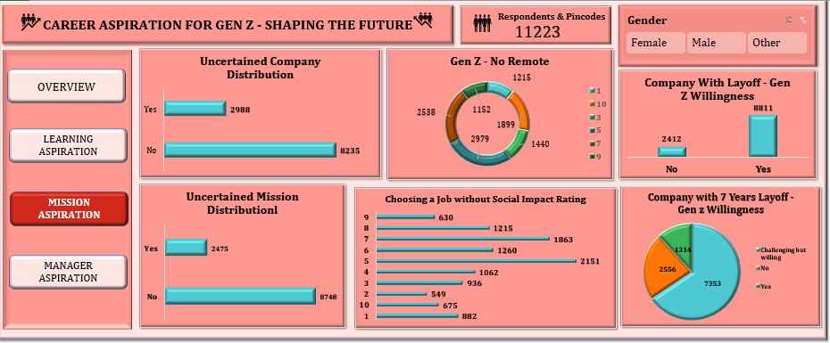
06

Slide 7
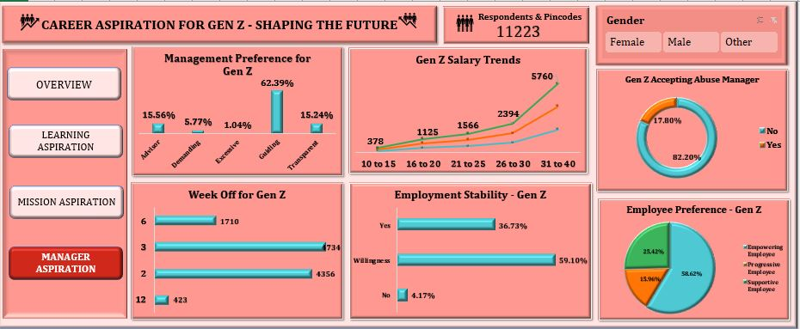
07

Slide 8
STAGE II
PROBLEM STATEMENT
08

Slide 9
WHAT
Primary Workflow Preference
Gen Z values roles with flexible work structures, including hybrid setups.
They prefer workflows that incorporate continuous learning and skill building opportunities.
They appreciate regular feedback and clear career development pathways.
Factors Shaping Workflow Preference
Desire for personal growth and professional development.
Need for work-life integration over traditional work-life balance.
A focus on meaningful, mission-driven work that aligns with personal values.
09
WWW.REALLYGREATSITE.COM

Slide 10
WHY
Need to Continuous Development
Gen Z have seen the importance of adaptability in a changing job market.
Desire to remain relevant and competitive by improving their skills regularly.
Importance of Flexibility in Workflow
Flexibility supports a healthier balance of personal and professional life.
Flexible workflows enable them to manage side projects or entrepreneurial interests alongside their careers.
They seek autonomy in how and when work is completed.
10
WWW.REALLYGREATSITE.COM

Slide 11
WHO
Influential Figures in Career Progression
Mentors and managers who offer regular and constructive feedback.
Professional networks, including online platforms and personal connections.
Influencers and thought leaders who demonstrate the importance of skills like adaptability and creativity.
Supportive Workplace Relationships
Managers who advocate for their growth and recognize their contributions.
Teams that foster collaboration and respect diverse perspectives.
Peer networks that encourage and support development.
11
WWW.REALLYGREATSITE.COM

Slide 12
WHERE
Preferred Work Environments
Flexible arrangements that include remote and hybrid work options.
Collaborative digital platforms that enable teamwork and innovation.
Job and Career Development Resources
Online learning platforms and certifications for continuously improving skills.
Professional social media channels like LinkedIn for networking and opportunities.
Industry-specific forums and communities for skill enhancement and job updates.
12
WWW.REALLYGREATSITE.COM

Slide 13
WHEN
Pace of Career Advancement
Expect rapid career progression and visible impact within a few years of starting a role.
Emphasis on frequent learning milestones and skill advancement within a short period.
Timing of Job Mobility
Typically seeks new roles or promotions every 1-3 years for better opportunities.
Driven by a need for new challenges, skill acquisition, and a path toward leadership roles.
13
WWW.REALLYGREATSITE.COM

Slide 14
HOW
Preferred Job Search Methods
Uses online job boards, company websites, and social media to find relevant roles.
Leverages networking events, virtual job fairs, and LinkedIn for connections and visibility.
Recommendations for Effective Recruitment
Highlight opportunities for growth and advancement in job postings.
Emphasize a culture of flexibility, inclusivity, and continuous learning.
Showcase the organization’s social responsibility initiatives and commitment to work-life integration.
14
WWW.REALLYGREATSITE.COM

Slide 15

CONCLUSION
To meet Gen Z’s career expectations, employers must embrace flexibility, meaningful work, and opportunities for growth. By adapting workplace culture and offering clear development paths, companies can attract and retain this talent. Likewise, Gen Z professionals should clearly communicate their goals and seek environments that align with their values, fostering mutual success.
15
WWW.REALLYGREATSITE.COM

Slide 16
STAGE III
DATA COLLECTION
16

Slide 17
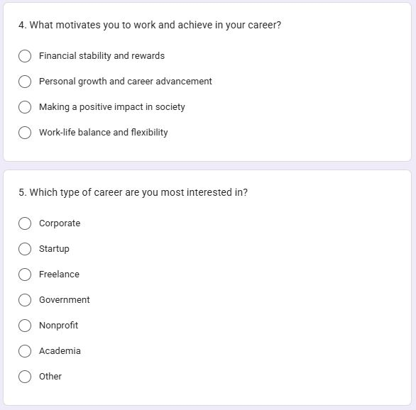

DATA COLLECTION
Google Form
17
WWW.REALLYGREATSITE.COM

Slide 18
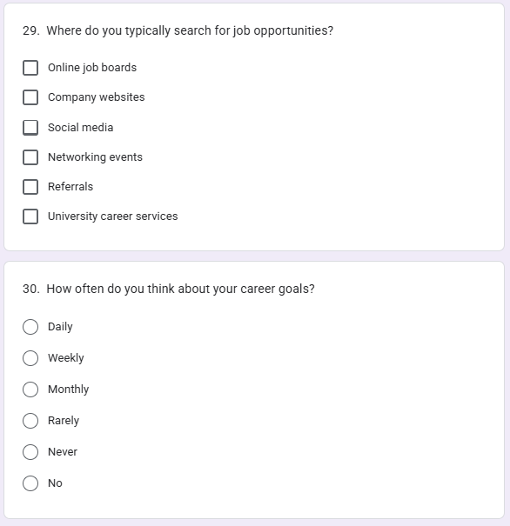
DATA COLLECTION
Google Form
18
WWW.REALLYGREATSITE.COM

Slide 19
STAGE IV
DATA ANALYSIS IN SQL
19

Slide 20
What industries are Gen-Z most interested in pursuing careers in?
SELECT Aspirational_Career, COUNT(*) AS Interest_Count FROM career GROUP BY Aspirational_Carreer ORDER BY Interest_Count DESC;
What are the top factors influencing Gen-Z’s career choices?
SELECT Influencing_Factors, COUNT(*) AS Influence_Count FROM career GROUP BY Influencing_Factors ORDER BY Influence_Count DESC;
What is the desired work environment for Gen-Z? (e.g., remote, hybrid, in-office)
SELECT Work_Preference, COUNT(*) AS Preference_Count FROM career GROUP BY Work_Preference ORDER BY Preference_Count DESC;
20
WWW.REALLYGREATSITE.COM

Slide 21
How do financial goals, such as salary and benefits, impact career aspirations among Gen-Z?
SELECT AVG(Minimum_Salary_Expectation_for_First_3_Years) AS Avg_Starting_Salary, AVG(Expected_Monthly_Salary_after_5_Years_Experience) AS Avg_Expected_Salary FROM career;
What role do personal values and social impact play in career choices for Gen-Z?
SELECT Social_Impact_Rating, COUNT(*) AS Count FROM career GROUP BY Social_Impact_Rating ORDER BY Count DESC;
21
WWW.REALLYGREATSITE.COM

Slide 22
STAGE V
POWER BI:
MANAGER ASPIRATION DASHBOARD
22

Slide 23
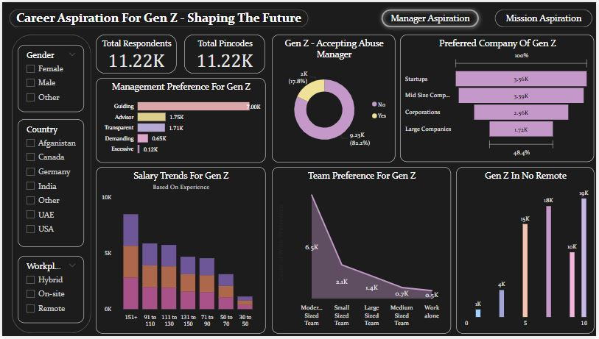
23

Slide 24
STAGE VI
POWER BI:
MISSION ASPIRATION DASHBOARD
24

Slide 25
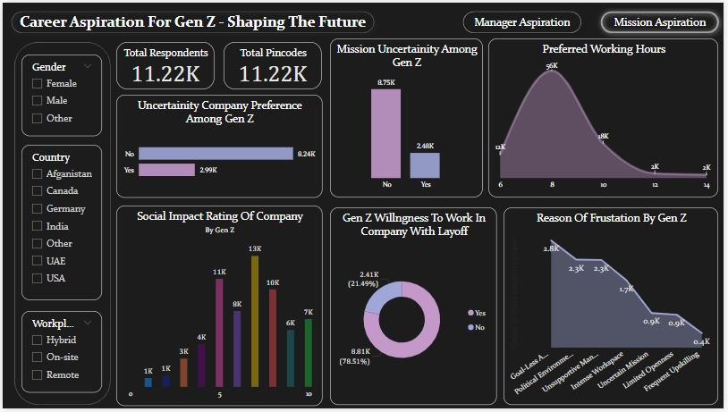
25

Slide 26

INSIGHTS
Structured mentorship and guided learning.
Ethical management and company culture.
Work-life balance.
Social impact and mission-driven work.
Companies with growth potential.
Flexible working arrangements.
26
WWW.REALLYGREATSITE.COM

Slide 27

RECOMMENDATIONS
Prioritize structured mentorship, guidance-based leadership, and clear career growth.
Offer hybrid work, strong work-life balance, and transparent communication.
Communicate social impact, provide meaningful work, and measure contributions.
Ensure transparent salaries, growth opportunities, and competitive benefits.
Strengthen onboarding, team connections, and feedback systems.
Develop robust learning and development platforms for career advancement.
27

Slide 28
thank
you!
28

